Slide 1
LOG4J
SPECIAL JAVA SUBJECT FSOFT – Developer – Part9

Slide 2
Introduction
Using the Log4J as a standard approach to logging.
Logging defined as “A record, as of the performance of a machine or the progress of an undertaking.” (Dictionary.com)

Slide 3
Logging vs. Debugging
Do programmers use debuggers or Loggers?
Logging is faster then using a debugger
Logging can be used to diagnose problems in the production stage as well as during development
Logging is easier than debugging in a distributed computing environment
To use logging as debugging tool we need to record lots of events
Note: The key to using a logger for debugging is to have lots of events recorded.

Slide 4
Logging activities
Note how similar this activities are.
Tracing
Debugging
Error Handling
Logging
(All write output to a storage device. Only the type of information written is different)

Slide 5
What is logged?
Types of information logged
Tracing the program flow, intercepting method calls
Detailed information about what occurs in a method at a granular level.
Information about a specific error that has occurred in the system.
Document historical business events that have occurred.
Interactions with users and other systems

Slide 6
Approaches to Logging
System.out.println
Not very fast (Poor performance
Not easy to customize. Could use like this:
Class Sample {
public static final boolean debug = true;
public void test(){
if (debug) System.out.println("Only during development");
}
}
Custom logging API
Build vs buy decision
Open Source (like Log4j)

Slide 7
Java Specification JSR47
Logging to serve various target groups
Configure logging from a property file and also at runtime
Log granularity (by function, by level, by custom filter)
Connect to existing logging services
Provide internationalization
Available for public review at http://java.sun.com/aboutJava/communityprocess/review/jsr047/index.html

Slide 8
Basic API
Printing messages are of the form:
debug(Object message, Throwable t)
debug(Object message)
If the 1st argument is a String object, it will be written in its present form. Other objects rendered by a registered Object renderer for its class or using the Object.toString() method.

Slide 9
Basic Usage Example
Standard usage:
class Foo {
Logger logger;
public Foo() {
logger = Logger.getInstance(getClass());
log.info(“Constructing foo”);
}
public String doStuff(long x){
log.debug(“doing stuff”);
}
}

Slide 10
Basic Concepts
Priority
Configuration:
log4j.properties or
log4j.xml
Log4j has three main components:
loggers: Responsible for capturing logging information.
appenders: Responsible for publishing logging information to various preferred destinations.
layouts: Responsible for formatting logging information in different styles.

Slide 11
log4j - Architecture
There are two types of objects available with log4j framework.
Core Objects: These are mandatory objects of the framework. They are required to use the framework.
Support Objects: These are optional objects of the framework. They support core objects to perform additional but important tasks.

Slide 12
Core Objects
Logger Object: The top-level layer is the Logger which provides the Logger object. The Logger object is responsible for capturing logging information and they are stored in a namespace hierarchy.
Layout Object: The layout layer provides objects which are used to format logging information in different styles, that is human-readable and reusable.
Appender Object: This is a lower-level layer which provides Appender objects. The Appender object is responsible for publishing logging information to various preferred destinations such as a database, file, console, UNIX Syslog, etc.

Slide 13
Support Objects
Level Object: defines the granularity and priority of any logging information. There are seven levels of logging defined within the API: OFF, FATAL, ERROR, WARN, INFO, DEBUG, and ALL.
Filter Object: is used to analyze logging information and make further decisions on whether that information should be logged or not. An Appender objects can have several Filter objects associated with them.
ObjectRenderer: is specialized in providing a String representation of different objects passed to the logging framework. This object is used by Layout objects to prepare the final logging information.
LogManager: manages the logging framework. It is responsible for reading the initial configuration parameters from a system-wide configuration file or a configuration class.
Notes:
ALL < DEBUG < INFO < WARN < ERROR < FATAL < OFF

Slide 14
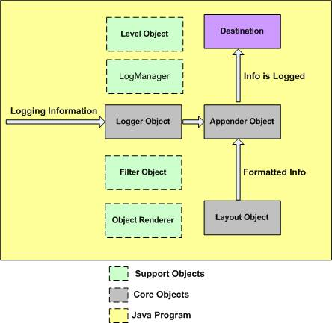
log4j - Architecture

Slide 15
log4j – Configuration (Properties)
Following is the syntax of log4j.properties file for an appender X:
# Define the root logger with appender X
log4j.rootLogger = DEBUG, X
# Set the appender named X to be a File appender
log4j.appender.X=org.apache.log4j.FileAppender
# Define the layout for X appender
log4j.appender.X.layout=org.apache.log4j.PatternLayout
log4j.appender.X.layout.conversionPattern=%m%n

Slide 16
log4j.properties Example
The level of the root logger is defined as DEBUG and attaches appender named FILE to it.
The appender FILE is defined as org.apache.log4j.FileAppender and writes to a file named "log.out" located in the log directory.
The layout pattern defined is %m%n, which means the printed logging message will be followed by a newline character.
# Define the root logger with appender file
log4j.rootLogger = DEBUG, FILE
# Define the file appender
log4j.appender.FILE=org.apache.log4j.FileAppender
log4j.appender.FILE.File=${log}/log.out
# Define the layout for file appender
log4j.appender.FILE.layout=org.apache.log4j.PatternLayout
log4j.appender.FILE.layout.conversionPattern=%m%n
Notes:
# disable logging
log4j.rootLogger=off, stdout

Slide 17
Using log4j in Java Program
import org.apache.log4j.Logger;
import java.io.*;
import java.sql.SQLException;
import java.util.*;
public class log4jExample{
/* Get actual class name to be printed on */
static Logger log = Logger.getLogger(log4jExample.class.getName());
public static void main(String[] args)throws IOException,SQLException{
log.debug("Hello this is a debug message");
log.info("Hello this is an info message");
}
}
Notes:
getLogger(“Tên package”) : apply cho tất cả các class trong gói
use Logger.getRootLogger().setLevel(Level.OFF); to disable any logging in java code
Or
Logger.getRootLogger().removeAllAppenders();
Logger.getRootLogger().addAppender(new NullAppender());

Slide 18
Priorities
Five recognized message priorities:
DEBUG, INFO, WARN, ERROR, FATAL
Priority specific log methods following the form:
debug(Object message);
debug(Object message, Throwable throwable);
General log methods for wrappers and custom priorities:
log(Priority level, Object message);
log(Priority level, Object message, Throwable throwable);

Slide 19
Loggers
Loggers define a hierarchy and give the programmer run-time control on which statements are printed or not.
Loggers are assigned priorities. A log statement is printed depending on its priority and its category.
Used to support output to multiple logs (Appenders) at the same time.
Log4j.category.com.mycompany.finance=INFO,FIN_Appender
This will direct all log messages in package com.mycompany.finance with priority > INFO to FIN_Appender.
Notes:
#to disable logging
Log4j.category.com.mycompany.finance=off
#to disable them programatically, you need to specify ALL OF THEM in the code:
Logger.getLogger("ac.biu.nlp.nlp.engineml").setLevel(Level.OFF);
Logger.getLogger("org.BIU.utils.logging.ExperimentLogger").setLevel(Level.OFF);
Logger.getRootLogger().setLevel(Level.OFF);

Slide 20
Root category
If no category is defined via a configuration file or programmatically, then all messages will be sent to the root category
All categories define a priority level and an Appender
Example of definition in (log4j.properties):
Log4j.rootCategory=WARN,ROOT_Appender

Slide 21
Appenders
An Appender is a object that sends log messages to their final destination
FileAppender – Write to a log file
SocketAppender – Dumps log output to a socket
SyslogAppender – Write to the syslog

Slide 22
Appenders continued
NTEventLogAppender – Write the logs to the NT Event Log system.
RollingFileAppender – After a certain size is reached it will rename the old file and start with a new one.
SocketAppender – Dumps log output to a socket
SMTPAppender – Send Messages to email
JMSAppender – Sends messages using Java Messaging Service
Or create your own. Not that difficult.

Slide 23
PatternLayout – Customize your message
Used to customize the layout of a log entry. The format is closely related to conversion pattern of the printf function in C. The following options are available:
c - Used to output the category of the logging event.
C - Used to output the fully qualified class name of the caller issuing the logging request.
d - Used to output the date of the logging event. The date conversion specifier may be followed by a date format specifier enclosed between braces. For example, %d{HH:mm:ss,SSS} or %d{dd MMM yyyy HH:mm:ss,SSS}. If no date format specifier is given then ISO8601 format is assumed
F - Used to output the file name where the logging request was issued.

Slide 24
PatternLayout – Customize your message
l - Used to output location information of the caller which generated the logging event. (C+M+L)
L - Used to output the line number from where the logging request was issued.
n - Outputs the platform dependent line separator character or characters.
M - Used to output the method name where the logging request was issued.
p - Used to output the priority of the logging event.
t - Used to output the name of the thread that generated the logging event.
x - Used to output the NDC (nested diagnostic context) associated with the thread that generated the logging event.

Slide 25
log4j.properties – Example 1
log4j.rootLogger=DEBUG, myAppender
log4j.appender.myAppender=org.apache.log4j.ConsoleAppender
log4j.appender.myAppender.layout=org.apache.log4j.PattenLayout
log4j.appender.myAppender.layout.ConversionPattern= \
%-4r [%t] %-5p %c %x - %m%n
Output example:
0 [main] INFO com.web.robot.WebRobotMain - WebRobotMain application started
2203 [main] INFO com.web.robot.WebRobotMain - Spring application context initialized
2203 [main] INFO com.web.robot.WebRobot - WebRobot started
2203 [main] INFO com.web.robot.impl.MainBookmarkProcessor - Starting to load bookmarks
7750 [main] INFO com.web.robot.impl.MainBookmarkProcessor - Totally [74] bookmarks loaded
7750 [main] INFO com.web.robot.WebRobot - [74] bookmarks loaded by
[com.web.robot.impl.MainBookmarkProcessor]
7750 [main] INFO com.web.robot.impl.MainBookmarkProcessor - Starting to process bookmarks
11234 [main] INFO com.web.robot.impl.MainBookmarkProcessor - Bookmarks processed:
[66] saved, [8] ignored
11234 [main] INFO com.web.robot.WebRobot - WebRobot finished
11234 [main] INFO com.web.robot.WebRobotMain - WebRobotMain finished

Slide 26
log4j.properties – Example 2
# Set options for appender named "ROOT_Appender"
# It should be a RollingFileAppender, with maximum file size of 10 MB# using at most one backup file. The layout is using a pattern layout. ISO8061 date format with context printing enabled.
log4j.appender.ROOT_Appender=org.log4j.RollingFileAppender
log4j.appender.ROOT_Appender.File=out.log
log4j.appender.ROOT_Appender.MaxFileSize=10MB
log4j.appender.ROOT_Appender.MaxBackupIndex=1
log4j.appender.ROOT_Appender.layout=org.log4j.PatternLayout
log4j.appender.ROOT_Appender.layout.ConversionPattern=%d{ISO8601} %p %t %x - %m%n
# Root category set to DEBUG using the ROOT_Appender appender defined above.
log4j.rootCategory=INFO, ROOT_Appender
log4j.category.com.emaritz.registration.ejb=DEBUG

Slide 27
LOG4J INSTALLING LOG4J LIBRARY

Slide 28
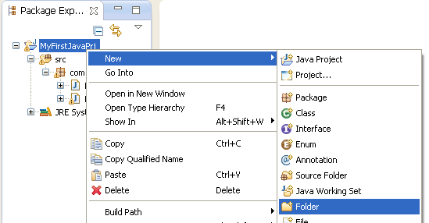
Add library folder
Notes:
Determine where the library stays
Then add library to project

Slide 29
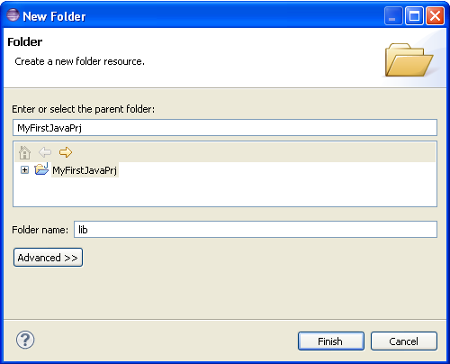
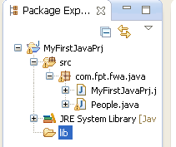
Add library folder dialog
Notes:
Determine where the library stays
Then add library to project

Slide 30
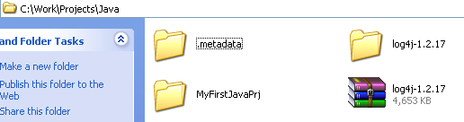
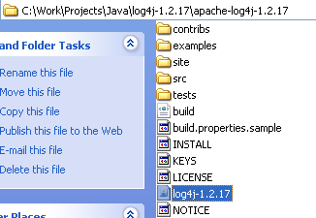

Copy library
Notes:
Determine where the library stays
Then copy library to the lib folder

Slide 31
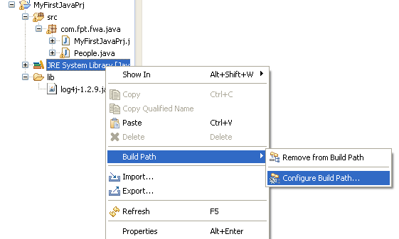
Add library
Notes:
Determine where the library stays
Then add library to project

Slide 32
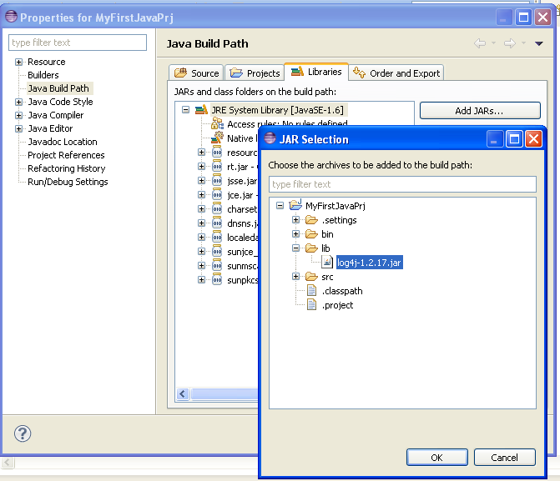
Add library dialog

Slide 33
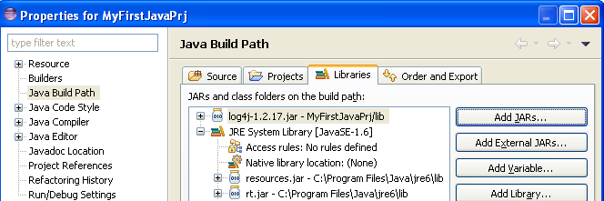
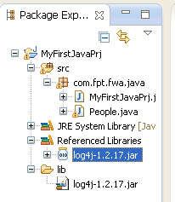
Add library result

Slide 34
LOG4J CONFIGURATION (XML)

Slide 35
Content
Add a new configuration file
Register to Assembly
Main structure
Appender Section
Logger Section

Slide 36
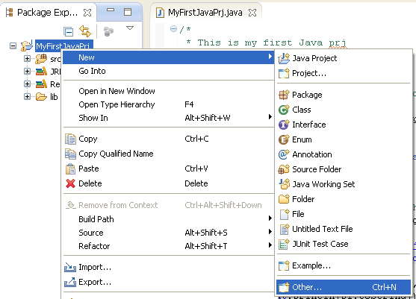
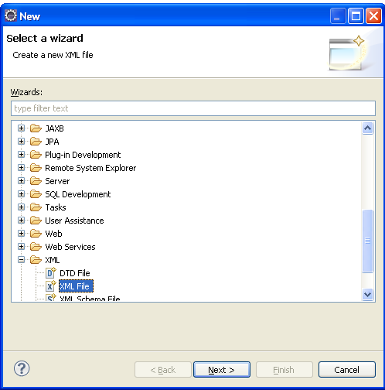
Creation XML Configuration file

Slide 37
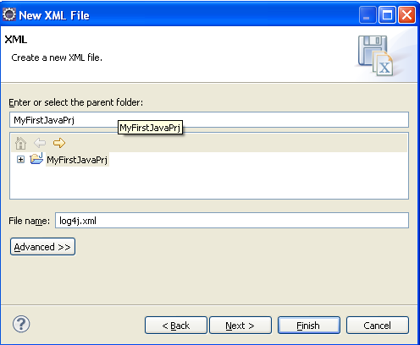
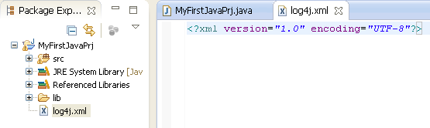
Creation XML Configuration file

Slide 38
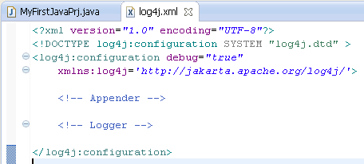
Main structure

Slide 39
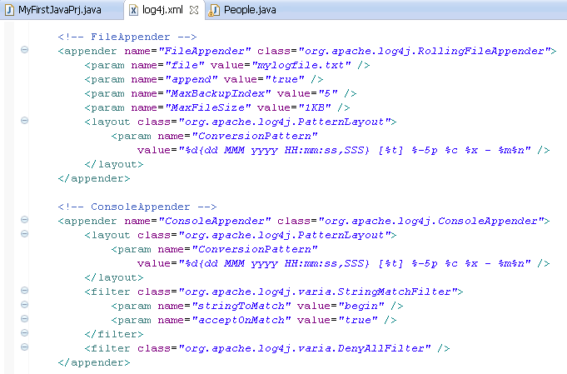
Appenders
Notes:
Present detail about any element of appender, attention to filter

Slide 40
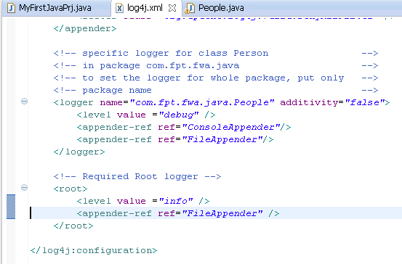
Loggers

Slide 41
Summary
Add a new configuration file: Add xml file to the root folder
Main structure: Appenders and loggers
Appender Section: File rolling and console
Logger Section: Root required and specific logger is optional

Slide 42
LOG4J INITIALIZE

Slide 43
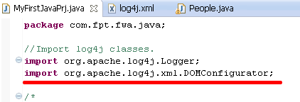
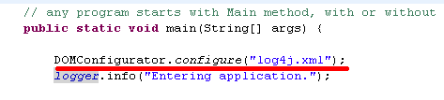
Initialization code
Notes:
Nếu đặt tên file cầu hình đúng quy định thì không cần đoạn code nói trên

Slide 44
LOGGING

Slide 45
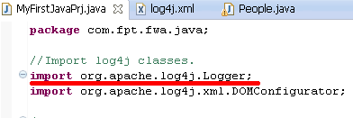
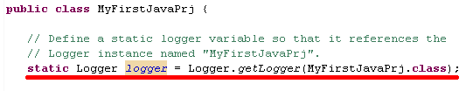
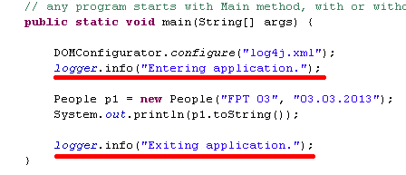
Add logging
Notes:
getLogger(“Tên package”) : apply cho tất cả các class trong gói

Slide 46
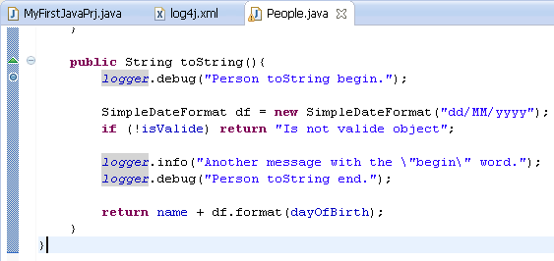
Multi level logging
Notes:
Last log event is not catch cause of Filter

Slide 47
RUNNING RESULT

Slide 48

Console Output

Slide 49
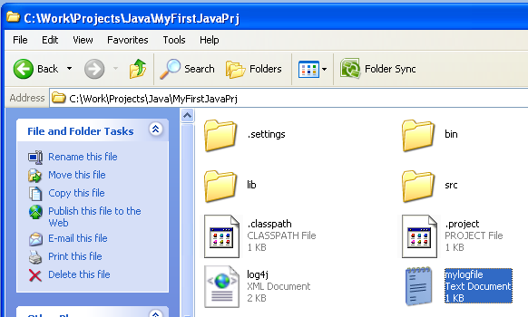
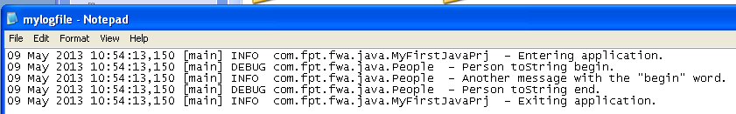
File Output
Notes:
Point out the folder and file name

Slide 50
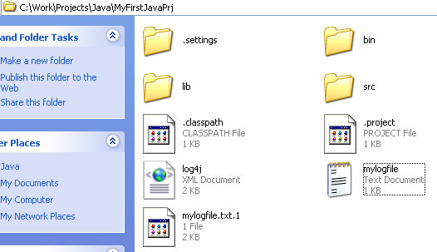
File Output: rolling
Notes:
The last line is not sent out cause of filter

Slide 51
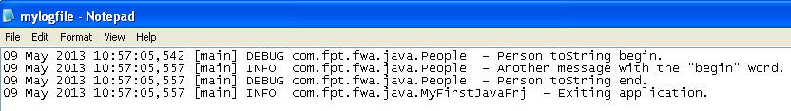
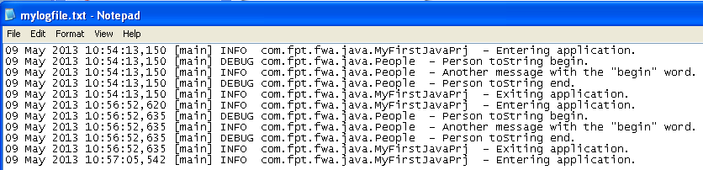
File Output: rolling file
Notes:
The last line is not sent out cause of filter

Slide 52
APPENDERS

Slide 53
Appender using
Notes:
Present detail about any element of appender, attention to filter

Slide 54
Appenders
File rolling
Console
File
Daily File rolling
JDBC – to Database
SMTP – by email
Other…
Notes:
All == Debug

Slide 55
LOG LEVELS

Slide 56
Loggers

Slide 57
Log level using
Notes:
All == Debug

Slide 58
Log levels
TRACE
DEBUG
INFO
WARN
ERROR
FATAL
Notes:
Order from Trace to Fatal
Logger with level Trace will display msg for all log level events
Logger with level Debug will display msg for all log level event from Debug to Fatal and so on

Slide 59
LAYOUT

Slide 60
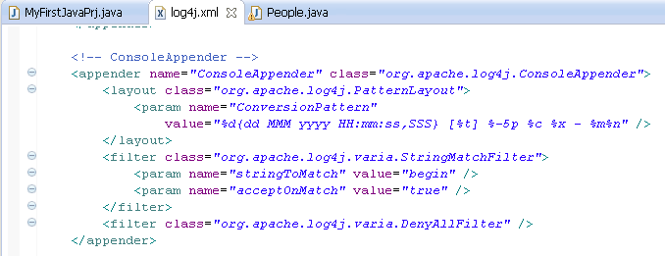
Layout using
Notes:
All == Debug

Slide 61
Layouts
PatternLayout
HTMLLayout
SimpleLayout
Notes:
PatternLayout Formats the logging event according to a flexible set of formatting flags.
HTMLLayout output in HTML table
SimpleLayout Formats the logging event very simply: [level] - [message]

Slide 62
FILTER

Slide 63
Filter using
Notes:
All == Debug

Slide 64
Filters
DenyAllFilter
LevelMatchFilter
LevelRangeFilter
StringMatchFilter
Notes:
Attention to filter order
DenyAllFilter Drops all “other” logging events.
LevelMatchFilter An exact match to the event's level.
LevelRangeFilter Matches against a range of levels.
StringMatchFilter Matches a substring from the event's message.

Slide 65
Lesson summary
Add Log4J library: add reference in build path
Create configuration file: xml file
Add logging initialization statements: in main java file
Add logging code: in each module
Appender overview: File rolling, console, SQL
Log level overview: 6 options
Layout overview: output format
Filter overview: output restriction

Slide 66
My Example – log4j.properties
log4j.rootLogger=ALL, CONSOLE ,FILE
log4j.appender.CONSOLE=org.apache.log4j.ConsoleAppender
log4j.appender.CONSOLE.layout=org.apache.log4j.PatternLayout
log4j.appender.CONSOLE.layout.ConversionPattern= %-4r [%t] %-5p %c %x - %m%n
# Direct log messages to a log file with INFO level
log4j.appender.FILE.Threshold=info
log4j.appender.FILE=org.apache.log4j.RollingFileAppender
log4j.appender.FILE.File=e:\\dest\\logigng.log
log4j.appender.FILE.MaxFileSize=10MB
log4j.appender.FILE.MaxBackupIndex=10
log4j.appender.FILE.layout=org.apache.log4j.PatternLayout
log4j.appender.FILE.layout.ConversionPattern=%d{yyyy-MM-dd HH:mm:ss} %-5p %c{1}:%L - %m%n

Slide 67
My Example - Log4JTest.java
package demo;
import org.apache.log4j.Logger;
import org.apache.log4j.PatternLayout;
public class Log4JTest {
static Logger log = Logger.getLogger("demo");
public static void main(String[] args) {
log.debug("This is a debug message");
log.info("This is an info message");
}
}

Slide 68


